Slide 1
Lecture 06 – NNs and Neural LMs
Baojian Zhou
DATA130030.01 (自然语言处理)
School of Data Science Fudan University
03/27/2024

Slide 2
Outline
Units in Neural Networks

Slide 3

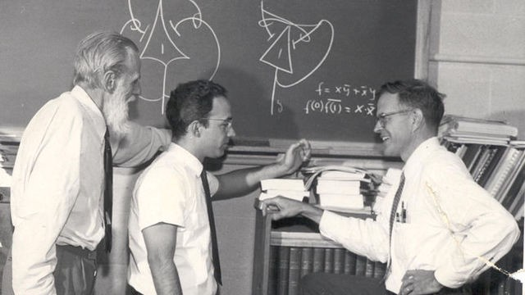
What is a neuron?
细胞体
突触
终树突
细胞核
轴突
神经突触节
高尔基体
First mathematical neuron: In 1943, Warren S. McCulloch, a neuroscientist, and Walter Pitts, a logician, published "A logical calculus of the ideas immanent in nervous activity" in the Bulletin of Mathematical Biophysics.
内质网
树突
线粒体
树突分支
By User BruceBlaus - Own work, CC BY 3.0, https://commons.wikimedia.org/w/index.php?curid=28761830
McCulloch-Pitts Neuron

Slide 4
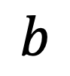
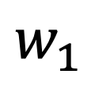
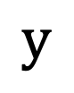
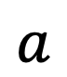
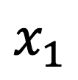
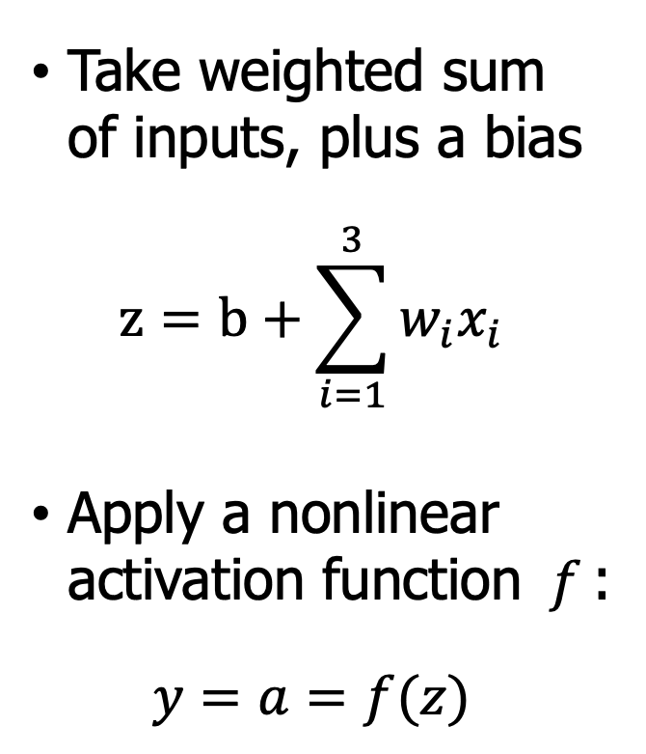

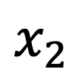

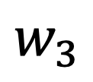
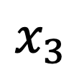

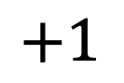
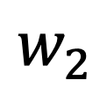
Neural network unit
Output value
$$y$$
Take weighted sum of inputs, plus a bias
$$z=b+\sum_{i=1}^{3}{w_{i}x_{i}}$$
Apply a nonlinear activation function $f$:
$$y=a=f(z)$$
$$a$$
Non-linear transform
$$σ$$
$$z$$
Weighted sum
Weights
$$w_{1}$$
$$w_{2}$$
$$w_{3}$$
$$b$$
Input layer
$$x_{1}$$
$$x_{2}$$
$$x_{3}$$
$$+1$$

Slide 5
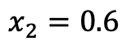
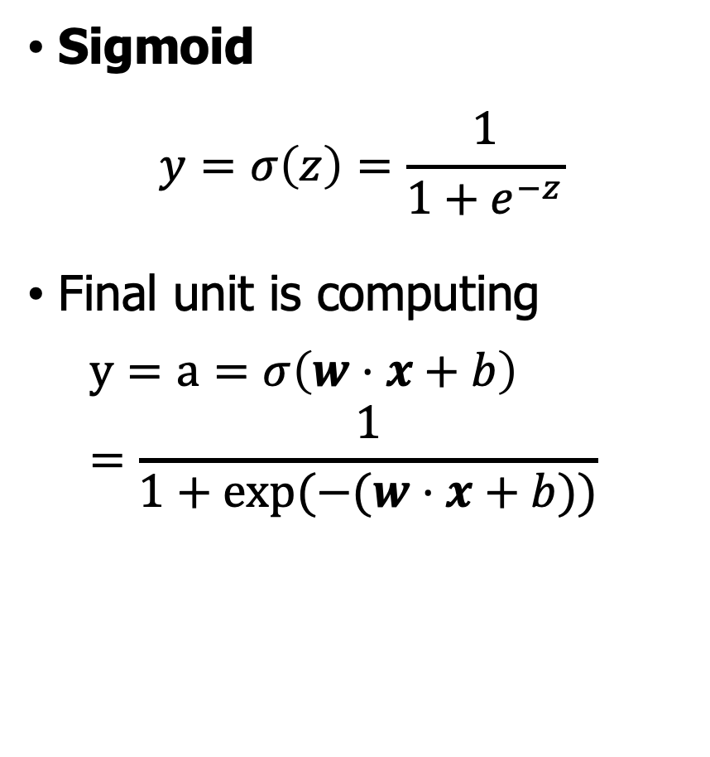

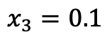
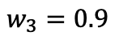
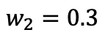

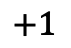
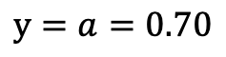
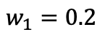
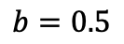
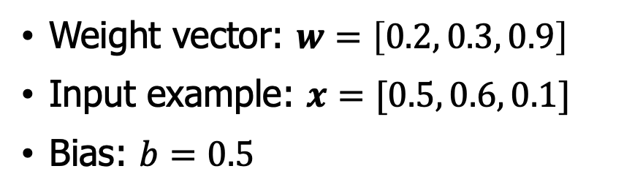
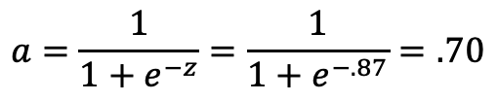
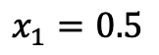
Non-Linear Activations
Sigmoid
$$y=σ\left(z\right)=\frac{1}{1+e^{−z}}$$
Final unit is computing
$$y=a=σ\left(w⋅x+b\right)=\frac{1}{1+\exp{(−(w⋅x+b))}}$$
$$y=a=0.70$$
$$a=\frac{1}{1+e^{−z}}=\frac{1}{1+e^{−.87}}=.70$$
$$σ$$
$$z=.2∗.5+.6∗.3+.1∗.9+.5=0.87$$
Weight vector: $w=\left[0.2, 0.3, 0.9\right]$
Input example: $x=[0.5, 0.6, 0.1]$
Bias: $b=0.5$
$$w_{1}=0.2$$
$$w_{2}=0.3$$
$$w_{3}=0.9$$
$$b=0.5$$
$$x_{1}=0.5$$
$$x_{2}=0.6$$
$$x_{3}=0.1$$
$$+1$$

Slide 6
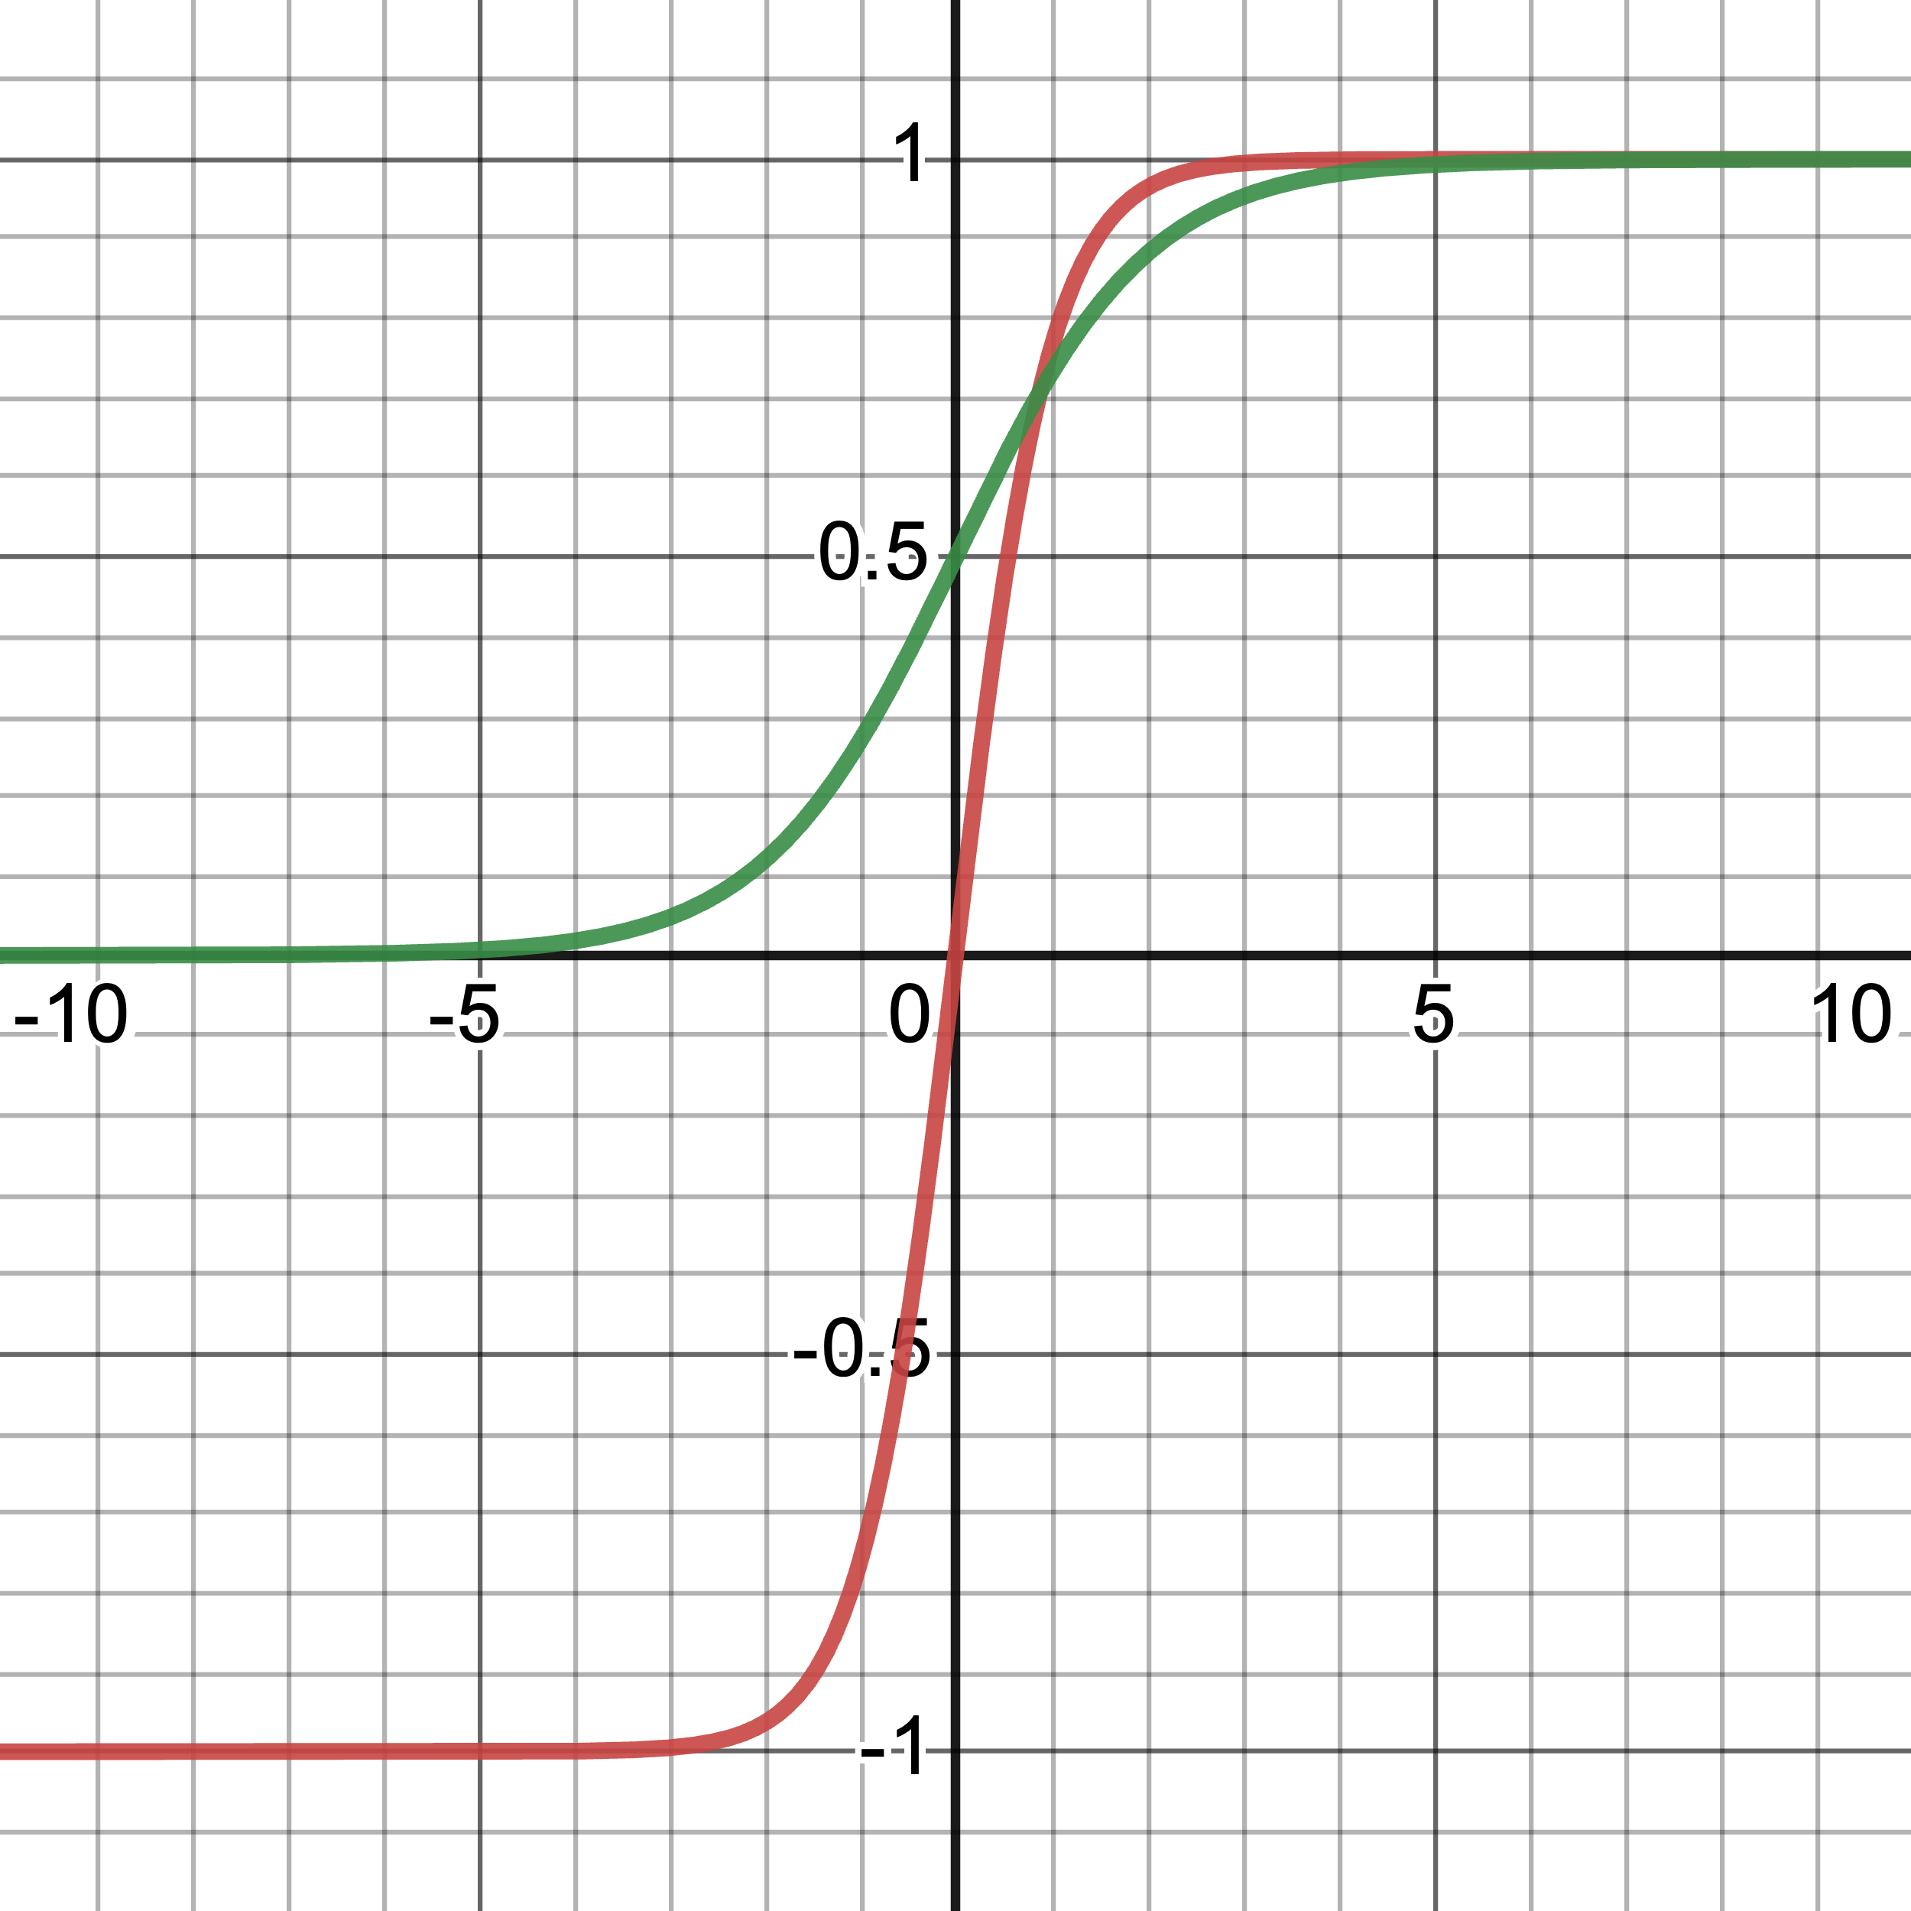
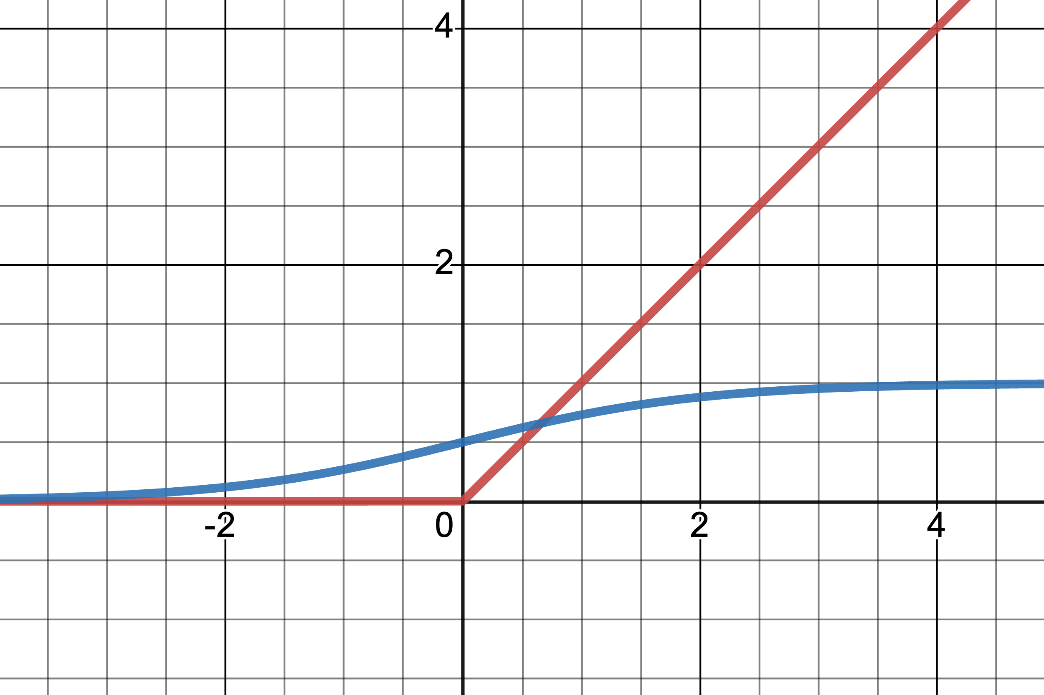
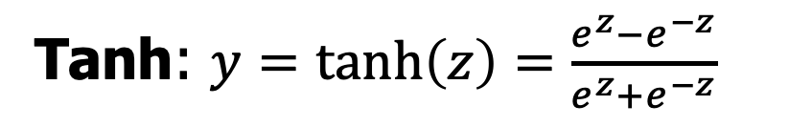

Non-Linear Activations
Tanh: $y=\tanh\left(z\right)=\frac{e^{z}−e^{−z}}{e^{z}+e^{−z}}$
Rectified Linear Unit (ReLU):
$$y=\max\left(z,0\right)$$
tanh
ReLU
sigmoid
sigmoid
Thanks to https://www.desmos.com/calculator

Slide 7
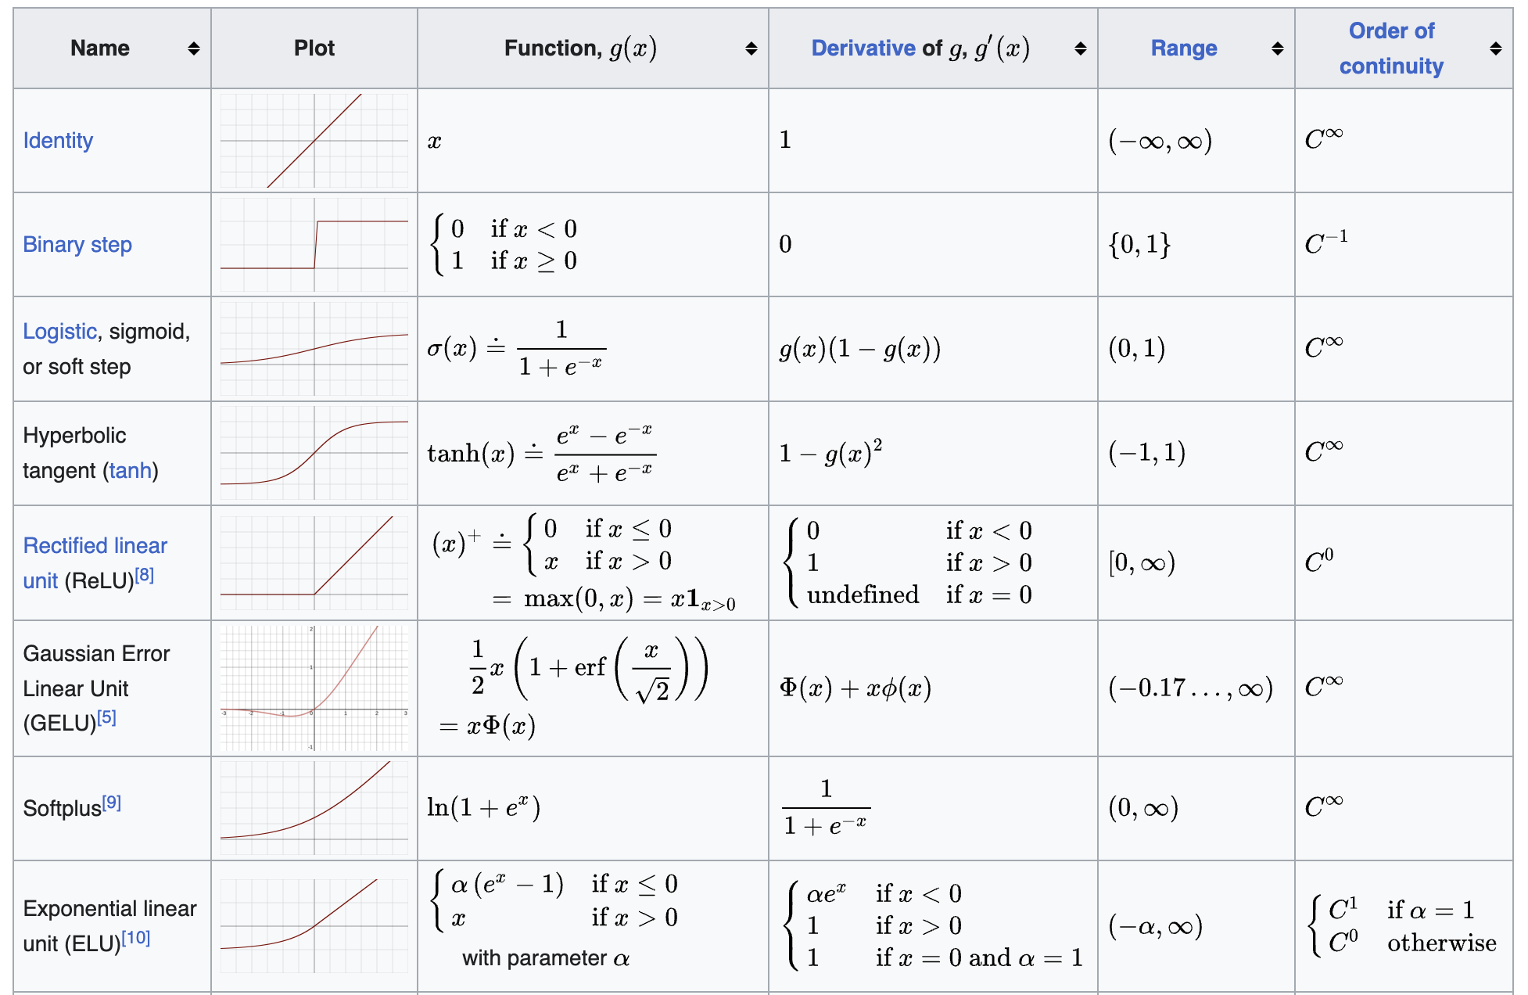
Other Non-Linear Activation Functions
https://en.wikipedia.org/wiki/Activation_function

Slide 8
Outline
Units in Neural Networks
The XOR problem

Slide 9
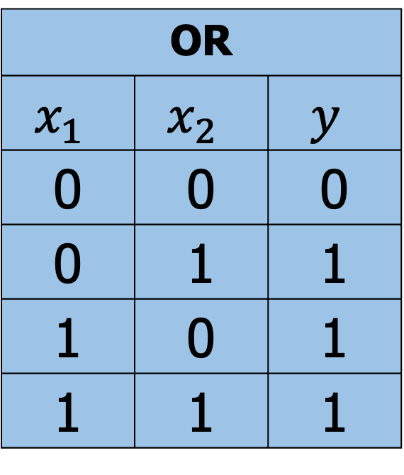
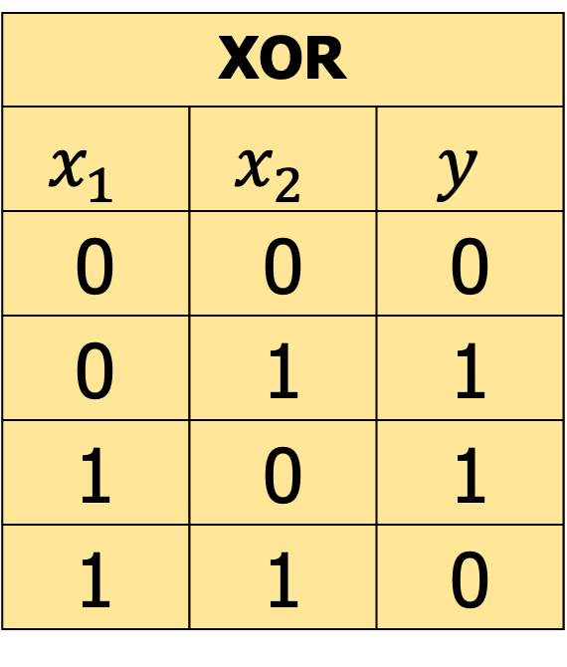
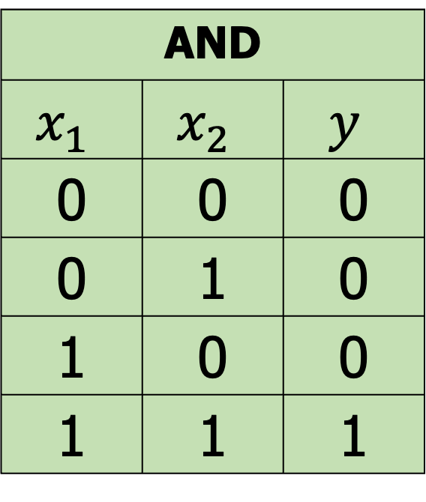
The XOR problem
AND
$$x_{1}$$ | $$x_{2}$$ | $$y$$
0 | 0 | 0
0 | 1 | 0
1 | 0 | 0
1 | 1 | 1
OR
$$x_{1}$$ | $$x_{2}$$ | $$y$$
0 | 0 | 0
0 | 1 | 1
1 | 0 | 1
1 | 1 | 1
XOR
$$x_{1}$$ | $$x_{2}$$ | $$y$$
0 | 0 | 0
0 | 1 | 1
1 | 0 | 1
1 | 1 | 0
Can single neural unit compute simple functions of input?

Slide 10
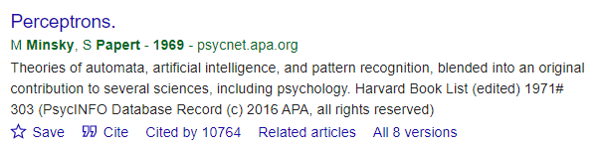
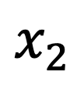

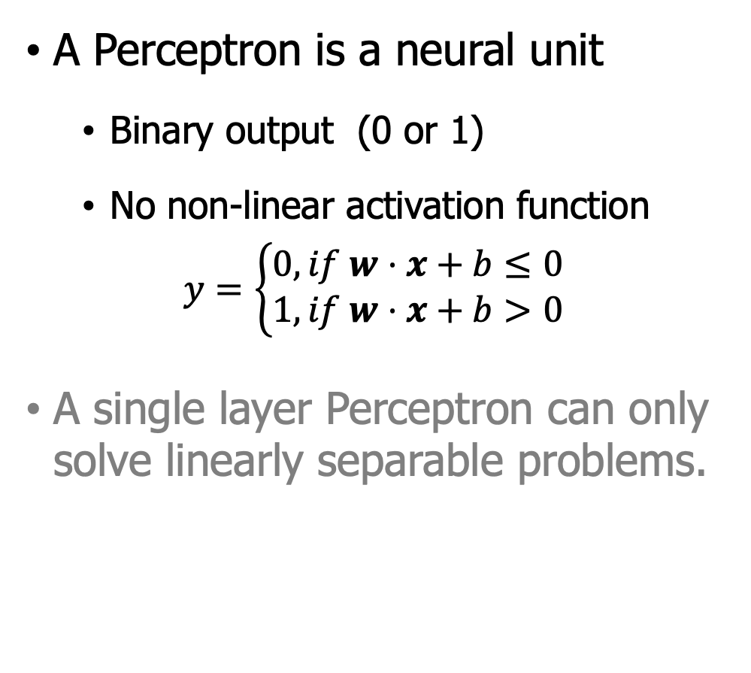
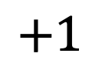
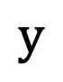
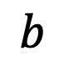
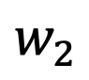

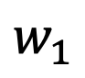
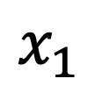
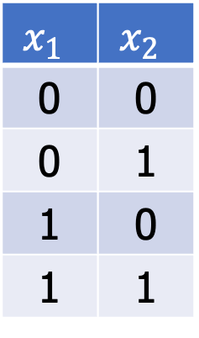
Single Layer Perceptron (SLP)
A Perceptron is a neural unit
Binary output (0 or 1)
No non-linear activation function
$$y=\left\{\begin{aligned}0, if w⋅x+b≤0 \\ 1, if w⋅x+b>0\end{aligned}\right.$$
A single layer Perceptron can only solve linearly separable problems.
$$y$$
$$x_{1}$$ | $$x_{2}$$
0 | 0
0 | 1
1 | 0
1 | 1
$$ReLU$$
$$w_{1}$$
$$w_{2}$$
$$b$$
$$x_{1}$$
$$x_{2}$$
$$+1$$
SLP
Minsky, Marvin, and Seymour Papert. “Perceptrons”, 1969.

Slide 11

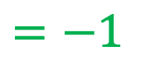
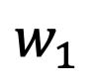

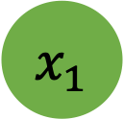

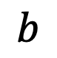
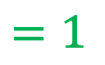
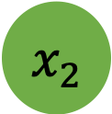
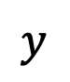
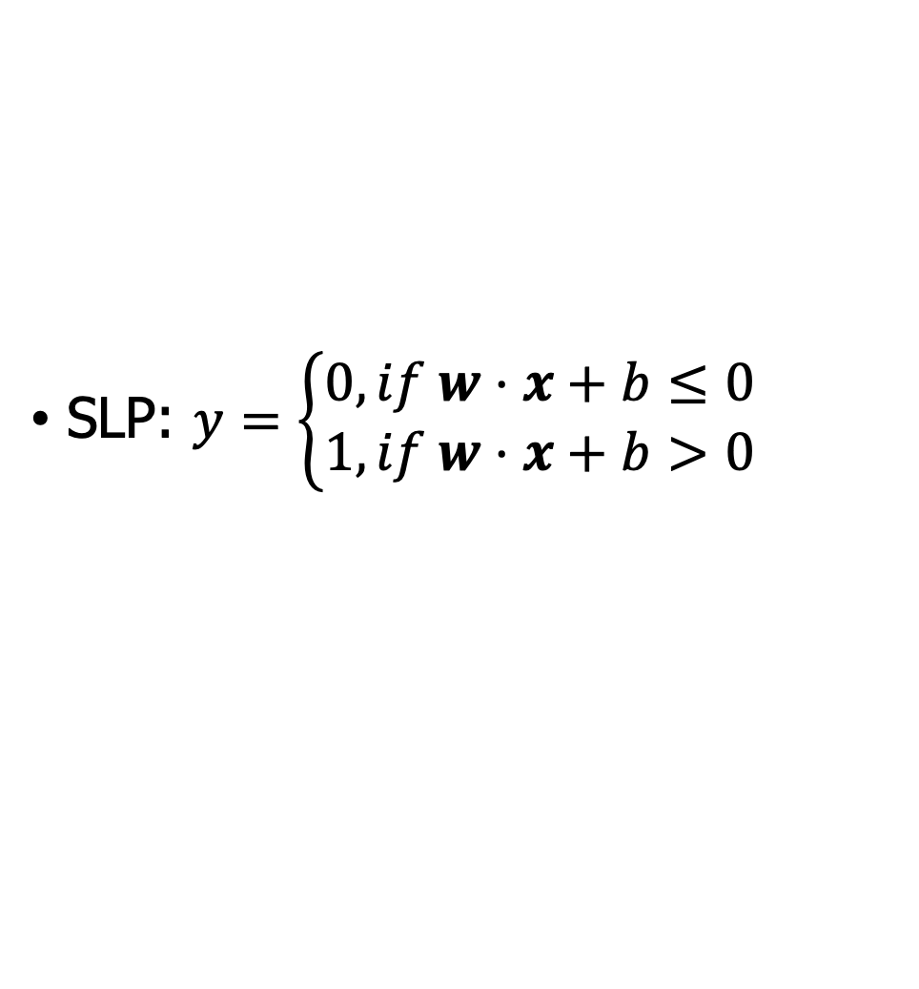
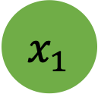











Easy to build AND or OR with SLP
SLP: $y=\left\{\begin{aligned}0, if w⋅x+b≤0 \\ 1, if w⋅x+b>0\end{aligned}\right.$
$$x_{1}$$
$$w_{1}$$
$$=1$$
$$x_{1}$$
$$w_{1}$$
AND
$$x_{1}$$ | $$x_{2}$$ | $$y$$
0 | 0 | 0
0 | 1 | 0
1 | 0 | 0
1 | 1 | 1
$$=1$$
OR
$$x_{1}$$ | $$x_{2}$$ | $$y$$
0 | 0 | 0
0 | 1 | 1
1 | 0 | 1
1 | 1 | 1
$$x_{2}$$
$$w_{2}$$
$$=1$$
$$ReLU$$
$$y$$
$$w_{2}$$
$$=1$$
$$ReLU$$
$$x_{2}$$
$$y$$
$$b$$
$$=−1$$
$$b$$
$$=0$$
+1
+1
AND
OR
How about setting weights:
$w=\left[1,1\right], b=−1$ ?
How about setting weights:
$w=\left[1,1\right], b=0$ ?
Solving AND and OR problem with SLP is easy.

Slide 12




















Is it possible to capture XOR with SLP?
SLP: $y=\left\{\begin{aligned}0, if w⋅x+b≤0 \\ 1, if w⋅x+b>0\end{aligned}\right.$
XOR
$$x_{1}$$ | $$x_{2}$$ | $$y$$
0 | 0 | 0
0 | 1 | 1
1 | 0 | 1
1 | 1 | 0
$$x_{1}$$
$$w_{1}$$
$$=1$$
$$x_{1}$$
$$w_{1}$$
$$=1$$
$$x_{2}$$
$$w_{2}$$
$$=1$$
$$ReLU$$
$$y$$
$$x_{2}$$
$$w_{2}$$
$$=1.1$$
$$ReLU$$
$$y$$
$$b$$
$$=−1$$
$$b$$
$$=−.9$$
+1
+1
Given this SLP, you can try many different $w$ and $b$, I am sure you will fail!
Fail when $x_{1}=0,x_{2}=1$
$w⋅x+b=0,$ so $y=0$
Fail when $x_{1}=1,x_{2}=1$
$w⋅x+b=1.2,$ so $y=1$

Slide 13




Why cannot? SLP is a linear classifier
SLP boundary is the equation of a line
$$w_{1}x_{1}+w_{2}x_{2}+b=0$$
Standard format: $x_{2}=\left(−\frac{w_{1}}{w_{2}}\right)x_{1}+\left(\frac{−b}{w_{2}}\right)$
The line acts as a decision boundary
0 if input is on one side of the line
1 if on the other side of the line
$$4⋅x_{1}+5⋅x_{2}−6=0$$
$$x=x_{1},y=x_{2}$$
$$w_{1}=4,w_{2}=5,b=−6$$

Slide 14






















Not possible to capture XOR with SLP
$$x_{2}$$
$$x_{2}$$
$$x_{2}$$
$$1$$
$$1$$
$$1$$
$$0$$
$$x_{1}$$
$$0$$
$$x_{1}$$
$$0$$
$$x_{1}$$
$$0$$
$$1$$
$$0$$
$$1$$
$$0$$
$$1$$
$x_{1}$AND $x_{2}$
$x_{1}$OR $x_{2}$
$x_{1}$XOR $x_{2}$
Data point with label $y=0$
Data point with label $y=1$
XOR is not linear separable!

Slide 15






















Solution to the XOR problem
XOR cannot be calculated by a single perceptron
XOR can be calculated by a layered network of units
XOR
$$x_{1}$$ | $$x_{2}$$ | $$y$$
0 | 0 | 0
0 | 1 | 1
1 | 0 | 1
1 | 1 | 0
$$x_{1}$$
$$w_{1}$$
$$x_{1}$$
$$w_{11}$$
$$h_{1}$$
$$w_{31}$$
$$w_{12}$$
$$y$$
$$w_{21}$$
$$w_{32}$$
$$x_{2}$$
$$w_{2}$$
$$x_{2}$$
$$ReLU$$
$$y$$
$$h_{2}$$
$$w_{22}$$
$$b$$
$$b_{1}$$
$$b_{2}$$
$$b_{3}$$
+1
+1
+1
SLP
NN: three ReLU units

Slide 16





















The hidden representation $h$
$$x_{1}$$
$$1$$
$$h_{1}$$
$$x_{2}$$
$$1$$
$$h_{2}$$
$$1$$
$$y$$
$$1$$
$$−2$$
$$1$$
$$x_{2}$$
$$1$$
$$1$$
$$h_{2}$$
$$0$$
$$−1$$
$$0$$
+1
+1
$$0$$
$$0$$
$$0$$
$$1$$
$$x_{1}$$
$$0$$
$$1$$
$$2$$
$$h_{1}$$
The original $x$ space
Neural Network
The new (linearly separable) $h$ space

Slide 17
Outline
Units in Neural Networks
The XOR problem
Feedforward Neural Networks (FNNs)

Slide 18











Feedforward Neural Networks (FNN)
$$x_{1}$$
$$W$$
$$h_{1}$$
$$U$$
$$y_{1}$$
FNN is multilayer network
Units are connected with no cycles
Outputs from units in each layer are passed to units in the next
Sometimes called Multi-Layer Perceptrons (or MLPs)
$$x_{2}$$
$$h_{2}$$
$$y_{2}$$
…
…
…
$$x_{n_{0}}$$
$$h_{n_{1}}$$
$$y_{n_{2}}$$
+1
Input Layer Hidden Layer Output Layer

Slide 19















Binary LR as a 1-layer Network
We don't count the input layer: Input layer=0th layer
$$y$$
Output layer $σ$ node
$$σ$$
$y=σ(w⋅x+b)$
(y is a scalar)
$w$ is a vector
$$w_{1}$$
$$w_{2}$$
$$w_{3}$$
$$w_{n}$$
$$b$$
Input layer vector $x$
$$x_{1}$$
$$x_{2}$$
$$x_{3}$$
…
$$x_{n}$$
+1

Slide 20











Multinomial LR as a 1-layer Network
Fully connected single layer network
Quick recall of Softmax
Output layer (softmax nodes)
$$y_{1}$$
…
$$y_{n}$$
$y=softmax(w⋅x+b)$
(y is a scalar)
$W$ is a matrix
$$W$$
$b$, a vector
Input layer $x$
$$x_{1}$$
$$x_{2}$$
$$x_{3}$$
$$x_{n}$$
+1

Slide 21
















Two-Layer Network with scalar output
Output layer
($σ$ nodes)
$$y$$
$y=σ(z)$ (y is a scalar)
$z=Uh$
$$U$$
Hidden units
($σ$ nodes)
$$h_{1}$$
$$h_{2}$$
$$h_{3}$$
$$h=σ\left(w⋅x+b\right)$$
Could be ReLU, tanh, ...
$$W$$
$b$ is a vector.
Input layer
vector $x$
$$x_{1}$$
$$x_{2}$$
$$x_{3}$$
$$x_{n}$$
+1

Slide 22



Two-Layer Network with scalar output
Output layer
($σ$ nodes)
$$y$$
$y=σ(z)$ (y is a scalar)
$z=Uh$
$$U$$
Hidden units
($σ$ nodes)
$$h_{1}$$
$$h_{j}$$
$$h_{3}$$
$$h=σ\left(w⋅x+b\right)$$
Could be ReLU, tanh, ...
$$W_{ij}$$
$$W$$
$b$ is a vector.
Input layer
vector $x$
$$x_{1}$$
$$x_{2}$$
$$x_{i}$$
$$x_{n}$$
+1

Slide 23


















Two-Layer Network with softmax output
Output layer
($σ$ nodes)
$$y_{1}$$
$$y_{2}$$
$$y_{3}$$
$y=σ(z)$ (y is a vector)
$z=Uh$
$$U$$
$$h=σ\left(w⋅x+b\right)$$
Hidden units
($σ$ nodes)
$$h_{1}$$
$$h_{2}$$
$$h_{3}$$
Could be ReLU, tanh ...
$$W$$
$b$ is a vector.
Input layer
vector $x$
$$x_{1}$$
$$x_{2}$$
$$x_{3}$$
$$x_{n}$$
+1

Slide 24













Single hidden layer notation
$$x_{1}$$
$$W$$
$$h_{1}$$
$$U$$
$$y_{1}$$
$$h=σ\left(Wx+b\right)$$
$z=Uh$
$y=softmax(z)$
$$x_{2}$$
$$h_{2}$$
$$y_{2}$$
…
…
…
$$x_{n_{0}}$$
$$h_{n_{1}}$$
$$y_{n_{2}}$$
+1
$$b$$
Input Layer Hidden Layer Output Layer

Slide 25















Multi-layer Notation
$${y=a}^{[2]}$$
$$b^{[2]}$$
$$W^{[2]}$$
$$a^{[2]}=g^{\left[2\right]}(z^{\left[2\right]})$$
$$a^{[1]}$$
$$z^{[2]}=W^{[2]}a^{[1]}+b^{[2]}$$
$$W^{[1]}$$
$$b^{[1]}$$
$$a^{[1]}=g^{\left[1\right]}\left(z^{\left[1\right]}\right)$$
$$z^{[1]}=W^{[1]}a^{[0]}+b^{[1]}$$
$$x_{1}$$
$$x_{2}$$
$$x_{3}$$
$$x_{n}$$
+1
$$a^{[0]}$$

Slide 26







Replacing the bias unit
Instead of: We do this:
$$x=x_{1},x_{2},…,x_{n_{0}}$$
$$x=x_{0},x_{1},x_{2},…,x_{n_{0}}$$
$$h=σ\left(Wx+b\right)$$
$$h=σ\left(Wx\right)$$
$$h_{j}=σ\left(\sum_{i=1}^{n_{0}}{W_{ji}x_{i}+b_{j}}\right)$$
$$h_{j}=σ\left(\sum_{i=0}^{n_{0}}{W_{ji}x_{i}}\right)$$
Add a dummy node $a0=1$ to each layer
Its weight w₀ will be the bias
So input layer a^{[0]}₀=1, a^{[1]}₀=1 , a^{[2]}₀=1,…

Slide 27





















Replacing the bias unit
Instead of:
We'll do this:
$$W$$
$$U$$
$$x_{1}$$
$$W$$
$$h_{1}$$
$$U$$
$$y_{1}$$
$$x_{0}$$
$$h_{1}$$
$$y_{1}$$
$$x_{1}$$
$$x_{2}$$
$$h_{2}$$
$$y_{2}$$
$$h_{2}$$
$$y_{2}$$
$$x_{2}$$
…
…
…
…
…
$$x_{n_{0}}$$
$$h_{n_{1}}$$
$$y_{n_{2}}$$
…
$$x_{n_{0}}$$
$$h_{n_{1}}$$
$$y_{n_{2}}$$
+1
$$b$$
$$b$$

Slide 28
Outline
Units in Neural Networks
The XOR problem
Feedforward Neural Networks (FNNs)
Applying FNNs to NLP tasks
Sentiment classification via FNNs

Slide 29

Recall: Sentiment classification
It's hokey . There are virtually no surprises , and the writing is second-rate. So why was it so enjoyable ? For one thing , the cast is great . Another nice touch is the music. I was overcome with the urge to get off the couch and start dancing. It sucked me in , and it'll do the same to you.
Variable | Definition | Value
$$x_{1}$$ | count(positive lexicon words $∈$ doc) | 3
$$x_{2}$$ | count(negative lexicon words $∈$ doc) | 2
$$x_{3}$$ | $\left\{\begin{aligned}1 if \text{no}∈doc \\ 0 otherwise\end{aligned}\right.$ | 1
$$x_{4}$$ | count(1st and 2nd pronouns $∈$ doc) | 3
$$x_{5}$$ | $\left\{\begin{aligned}1 if !∈doc \\ 0 otherwise\end{aligned}\right.$ | 0
$$x_{6}$$ | log(word count of doc) | $$\ln\left(66\right)=4.19$$

Slide 30







Classification: Sentiment Analysis
We could do exactly what we did with logistic regression
Input layer are features as before
Output layer is 0 or 1
$$σ$$
U
Variable | Definition | Value
$$x_{1}$$ | count(positive lexicon words $∈$ doc) | 3
$$x_{2}$$ | count(negative lexicon words $∈$ doc) | 2
$$x_{3}$$ | $\left\{\begin{aligned}1 if \text{no}∈doc \\ 0 otherwise\end{aligned}\right.$ | 1
$$x_{4}$$ | count(1st and 2nd pronouns $∈$ doc) | 3
$$x_{5}$$ | $\left\{\begin{aligned}1 if !∈doc \\ 0 otherwise\end{aligned}\right.$ | 0
$$x_{6}$$ | log(word count of doc) | $$\ln\left(66\right)=4.19$$
W
$$x_{1}$$
$$x_{2}$$
$$x_{3}$$
$$x_{4}$$
$$x_{n}$$

Slide 31






















FNNs for simple classification
Logistic Regression
2-layer feedforward network
$$σ$$
$$σ$$
U
…
$$w_{n}$$
Hidden layer
$$w_{1}$$
$$w_{2}$$
$$w_{3}$$
W
$$x_{1}$$
$$x_{2}$$
$$x_{3}$$
$$x_{n}$$
…
$$x_{1}$$
$$x_{2}$$
$$x_{3}$$
$$x_{n}$$
$$feature 1$$
$$feature 2$$
$$feature 3$$
$$feature n$$
$$feature 1$$
$$feature 2$$
$$feature 3$$
$$feature n$$
Just adding a hidden layer to logistic regression
allows the network to use non-linear interactions between features
which may (or may not) improve performance

Slide 32

2-layer FNN classifier
Input layer
Scalar features like, $x_{1} = count(words∈doc)$, $x2 = count(positive words∈ doc)$ etc.
Output layer
2 nodes (one each for positive and negative)
3 nodes (positive, negative, neutral)
The 2-layer model could be
$x=[x_{1},x_{2},…, x_{N}]$ each $x_{i}$ is a hand-designed feature.
$h=σ(Wx+b)$
$z=Uh$
$\hat{y}=softmax\left(z\right)$

Slide 33


















2-layer FNN classifier
$$h_{1}$$
wordcount =3
$$x_{1}$$
$${\hat{y}}_{1}$$
$$p(posi)$$
dessert
$$h_{2}$$
positive lexicon words = 1
$$x_{2}$$
$${\hat{y}}_{2}$$
was
$$h_{3}$$
$$p(nega)$$
count of “no” =0
$$x_{3}$$
…
$${\hat{y}}_{3}$$
$$p(neut)$$
great
$$h_{d}$$
…
Input words
$$x∈ℝ^{n}$$
$W∈ℝ^{n×d}$
$h∈ℝ^{d}$
$U∈ℝ^{3×d}$
$y∈ℝ^{3}$
Can we do better? How ?

Slide 34

Even better: representation learning
Instead of using hand-built human-engineered features for classification, use learned representations like embeddings!
The pic is from Fast Forward labs, https://blog.fastforwardlabs.com/2020/11/15/representation-learning-101-for-software-engineers.html

Slide 35



FNN classifier with embeddings
Representing words as embeddings(e.g., word2vec or GloVe vectors)
From text sample to feature vector: Design a pooling function for all the words in the input, e.g.,
$$x_{mean}=\frac{1}{n}\sum_{i=1}^{n}{e(w_{i})}$$
Word representations
dessert
was
great
this
.
.
.
the
which
2
0.1
0.3
-2
0.5
0.2
-2
0.2
4
0.7
0.2
0.8
.
.
.
.
.
.
.
.
.
$$x=x_{mean}$$
$h=σ(Wx+b)$
$z=Uh$
$\hat{y}=softmax\left(z\right)$
Other options of $x$:
element-wise max
Weighted mean
…
1
3
0.7
5
3
0.2

Slide 36

FNN classifier with embeddings

Slide 37

Concept of pretraining
Pretraining: The idea of using word2vec or GloVe embeddings as our inputs —and more generally the idea of relying on another algorithm to have already learned an embedding for our inputs
BERT: Pre-training of Deep Bidirectional Transformers for Language Understanding

Slide 38
Outline
Units in Neural Networks
The XOR problem
Feedforward Neural Networks
Applying feedforward networks to NLP tasks
Sentiment classification via FNNs
Neural Language Models (LMs)

Slide 39

Neural Language Models (LMs)
Language Modeling: Calculating the probability of the next word in a sequence given some history
We've seen $N$-gram based LMs
Neural network LMs far outperform $N$-gram language models
State-of-the-art neural LMs are based on more powerful neural network technology like Transformers
But simple feedforward LMs can do almost as well!

Slide 40

Simple FNN Neural Language Models
Same as $N$-gram model
Task: given prior words $w_{1}$, $w_{2}$, $w_{3}$, …, predict next word $w_{t}$ , we use sliding windows
$$p\left(w_{t}|w_{1},…,w_{t−1}\right)≈P\left(w_{t} | w_{t−N+1},…, w_{t−1}\right)$$
Neural language models represent words in the prior context by their embeddings
Example sentence for training:
I have to make sure that the cat gets fed.

Slide 41
Why Neural LMs work better than N-gram LMs
$N$-gram LMs: represent words by their word identity
Neural LMs: represent words in this prior context by their embeddings
Training data
I have to make sure that the cat gets fed.
Never seen dog gets fed
Test data:
I forgot to make sure that the dog gets _?_
$N$-gram LMs can't predict "fed"
Neural LMs can use similarity of "cat" and "dog" embeddings to generalize and predict “fed” after dog

Slide 42

Forward inference in the neural LM
Forward inference (decoding) for LM: Given an input, of running a forward pass on the network to produce a probability distribution over possible next words
Represent each of the $N$ previous words as a one-hot vector of length $|V|$
Multiply these one-hot vectors by the embedding matrix $E$, then feed the embedding to the neural network

Slide 43

Neural LMs with embeddings
For $P(w_{t}|w_{t−3}w_{t−2}w_{t−1})$, at each timestep:
Get a $d$-dimensional embedding for each context word
Concatenates the 3 resulting embeddings to get the embedding layer $e$
Embedding vector $e$ is multiplied by a weight matrix $W$ and then an activation is applied to produce the hidden layer $h$
Multiply by $U$ and apply softmax in final
$$e=\left[Ex_{t−3},Ex_{t−2},Ex_{t−1}\right]$$
$h=σ\left(We+b\right)$
$z=Uh$
$\hat{Y}=softmax (z)$

Slide 44

NLM with embeddings as parameters
Learn the embeddings simultaneously with training the network.
Useful when the task the network is designed for (like sentiment classification, translation, or parsing)
Embeddings as model parameters

Slide 45
Outline
Units in Neural Networks
The XOR problem
Feedforward Neural Networks (FNNs)
Applying feedforward networks to NLP tasks
Sentiment classification via FNNs
Neural Language Models (LMs)
Training Neural Nets

Slide 46

















Intuition: training a 2-layer Network
Actual answer $y$
$$y_{1}$$
$$y_{2}$$
$$y_{3}$$
Loss L($\hat{y},y$)
$${\hat{y}}_{1}$$
$${\hat{y}}_{2}$$
$${\hat{y}}_{3}$$
System output $\hat{y}$
$$U$$
Backward pass
$$h_{1}$$
$$h_{2}$$
$$h_{3}$$
Forward pass
Gradient
$$W$$
$$b$$
Training instance
$$x_{1}$$
$$x_{2}$$
$$x_{3}$$
$$x_{n}$$
+1

Slide 47

Intuition: training a 2-layer network
For every training tuple $(x,y)$
Run forward computation to find our estimate $\hat{y}$
Run backward computation to update weights:
For every output : Compute loss $L$between true $y$ and the estimated $\hat{y}$
For every weight $w$from hidden layer to the output layer: Update the weight

Slide 48




Reminder: Loss Function for classification
Cross entropy loss for binary classification:
Cross entropy loss for multinomial classification:
If $y$ is a one-hot, then CE loss is simply the negative log of the output probability corresponding to the correct class
$L_{CE}\left(\hat{y},y\right)=−\log{p\left(y|x\right)=−\left[y\log{\hat{y}+\left(1−y\right)\log\left(1−\hat{y}\right)}\right]}$
$L_{CE}\left(\hat{y},y\right)=−\sum_{k=1}^{K}{y_{k}\log{{\hat{y}}_{k}}}$
$=−\sum_{k=1}^{K}{\left\{y_{k}=1\right\}\log{{\hat{y}}_{k}}}=−\log{{\hat{y}}_{c}}$ ($c$ is the true label)
$=−\sum_{k=1}^{K}{\frac{exp⁡(z_{c})}{\sum_{j=1}^{K}{exp⁡(z_{j})}}}$

Slide 49















Computing the gradient explicitly
$\frac{∂L_{CE}(\hat{y},y)}{∂w_{j}}=\left(\hat{y}−y\right)⋅x_{j}=\left[σ\left(w⋅x+b\right)−y\right]⋅x_{j}$
$\frac{∂L_{CE}(\hat{y},y)}{∂W_{k,i}}=\left({\hat{y}}_{k}−y_{k}\right)⋅x_{i}=\left(\frac{\exp\left(w_{k}⋅x+b_{k}\right)}{\sum_{j=1}^{K}{exp⁡(w_{j}⋅x+b_{j})}}−y_{k}\right)x_{i}$
$$y$$
$$y_{1}$$
…
$$y_{K}$$
$$w$$
$$b$$
$$W$$
$$b$$
$$x_{1}$$
$$x_{2}$$
$$x_{3}$$
$$x_{n}$$
+1
$$x_{1}$$
$$x_{2}$$
$$x_{3}$$
$$x_{n}$$
+1

Slide 50














Where did that derivative come from?
$$y$$
Using the chain rule! f (x) = u(v(x))
$$a$$
$$σ$$
$$z$$
$\frac{∂L}{∂w_{i}}=\frac{∂L}{∂y}$ $\frac{∂y}{∂z}$ $\frac{∂z}{∂w_{i}}$
$$w_{1}$$
$$w_{2}$$
$$w_{3}$$
$$b$$
How can we efficiently get derivative for deep neural network?
$$x_{1}$$
$$x_{2}$$
$$x_{3}$$
$$+1$$

Slide 51













Computation Graphs
Computation graph: the process of computing a mathematical expression
$$L\left(a,b,c\right)=c\left(a+2b\right)$$
Make each of the component $+$ and $×$ operations explicit
Add names ($d$ and $e$) for the intermediate outputs loss:
$$d=2×b, e=a+d$$
$$L\left(c,e\right)=c×e$$
$$a$$
$$a=3$$
$$e=a+d$$
$$d=2$$
$$e=5$$
$$b=1$$
$$b$$
$$d=2b$$
$$L=ce$$
$$L=−10$$
$$c=−2$$
$$c$$
Forward pass of the comp. graph

Slide 52
Why computation graphs
For training, we need the derivative of the loss with respect to each weight in every layer of the network
But the loss is computed only at the very end of the network!
Backpropagation (Rumelhart, Hinton, Williams, 1986)
Backprop is a special case of backward differentiation, which relies on computation graphs.

Slide 53


Backward differentiation via chain rule
Backward pass: used to compute the derivatives for updating weights
$$L\left(a,b,c\right)=c\left(a+2b\right)$$
$$d=2×b, e=a+d$$
$$L\left(c,e\right)=c×e$$
We want the derivatives
$\frac{∂L}{∂a}, \frac{∂L}{∂b}, \frac{∂L}{∂c}$
Backward differentiation: makes use of the chain rule in calculus. Given $f\left(x\right)=u(v(x))$, the derivative $\frac{df}{dx}$ is
$$\frac{df}{dx}=\frac{du}{dv}⋅\frac{dv}{dx}$$
For more than two functions, $f\left(x\right)=u(v(w(x)))$, the derivative of $x$ is
$$\frac{df}{dx}=\frac{du}{dv}⋅\frac{dv}{dw}⋅\frac{dw}{dx}$$

Slide 54









Backward differentiation
Pass gradients back from the final node to all the nodes in the graph.
To calculate $\frac{∂L}{∂d},$ we have the following path from the comp. graph
Each node (e.g., $e$) takes an upstream gradient, multiplies it by the local gradient (the gradient of its output with respect to its input), and uses the chain rule to compute a downstream gradient
$$d$$
$$e$$
$$d=2b$$
$$e=a+d$$
$$L=ce$$
$$\frac{∂L}{∂d}=\frac{∂L}{∂e}⋅\frac{∂e}{∂d}$$
$$\frac{∂e}{∂d}$$
$$\frac{∂L}{∂e}$$
Downstream gradient
Local gradient
Upstream gradient

Slide 55

Backward differentiation
We want $\frac{∂L}{∂a}, \frac{∂L}{∂b}, \frac{∂L}{∂c}$
$$\frac{∂L}{∂c }=e,$$
$$\frac{∂L}{∂a}=\frac{∂L}{∂e}⋅\frac{∂e}{∂a},$$
$$\frac{∂L}{∂b}=\frac{∂L}{∂e}⋅\frac{∂e}{∂d}⋅\frac{∂d}{∂b}$$
Five intermediate derivatives
$$\frac{∂L}{∂e}, \frac{∂L}{∂c }, \frac{∂e}{∂a}, \frac{∂e}{∂d}, \frac{∂d}{∂b}$$
$$a$$
$$e=a+d$$
$$b$$
$$d=2b$$
$$L=ce$$
$$c$$

Slide 56



















Backward differentiation on comp. graph
$$a$$
$$a=3$$
$$e=a+d$$
$$\frac{∂L}{∂a}=\frac{∂L}{∂e}⋅\frac{∂e}{∂a}=−2$$
$$\frac{∂L}{∂e}=−2$$
$$\frac{∂e}{∂a}=1,\frac{∂e}{∂d}=1$$
$$d=2$$
$$e=5$$
$$L=−10$$
$$b=1$$
$$\frac{∂L}{∂d}=\frac{∂L}{∂e}⋅\frac{∂e}{∂d}=−2$$
$$L=ce$$
$$b$$
$$d=2b$$
$$\frac{∂L}{∂b}=\frac{∂L}{∂d}⋅\frac{∂d}{∂b}=−4$$
$$\frac{∂d}{∂b}=2$$
$$\frac{∂L}{∂e}=−2$$
$$\frac{∂L}{∂c}=5$$
$$c=−2$$
$$c$$
$$\frac{∂L}{∂c}=5$$

Slide 57
















Backward differentiation for NNs
$$y$$
$$σ$$
$$W^{[2]}$$
$$b^{[2]}$$
$$z^{[1]}=W^{[1]}a^{[0]}+b^{[1]}$$
$$a^{[1]}=g^{\left[1\right]}\left(z^{\left[1\right]}\right)$$
ReLU activation
$$z^{[2]}=W^{[2]}a^{[1]}+b^{[2]}$$
$$a^{[2]}=g^{\left[2\right]}(z^{\left[2\right]})$$
$$W^{[1]}$$
$$b^{[1]}$$
$$\hat{y}=a^{[2]}$$
$$x_{1}$$
$$x_{2}$$
$$x_{3}$$
$$x_{n}$$
+1
$$a^{[0]}$$

Slide 58






Example of: $∂L/∂z$
Write $a$ f$or a^{[2]}$ and $z$ for $z^{[2]}$
$$L\left(\hat{y},y\right)=−\left(\text{y}\log{(\hat{y})}+\left(1−y\right)log⁡(1−\hat{y}\text{)}\right)$$
$$L\left(a,y\right)=−\left(y log{a}+\left(1−y\right)log⁡(1−a)\right)$$
$\frac{∂L}{∂z}=\frac{∂L}{∂a}$ $\frac{∂a}{∂z}$
$$\frac{∂L}{∂a}=−\left(\left(y\frac{∂\log\left(a\right)}{∂a}\right)+(1−y) \frac{∂\log\left(1−a\right)}{∂a}\right)$$
$$=−\left(\left(y\frac{1}{a}\right)+\left(1−y\right) \frac{1}{1−a}\left(−1\right)\right)=−\left(\frac{y}{a}+\frac{y−1}{1−a}\right)$$
$$\frac{∂a}{∂z}=a(1−a)$$
$$\frac{∂L}{∂z}=−\left(\frac{y}{a}+\frac{y−1}{1−a}\right)a\left(1−a\right)=a−y$$

Slide 59

Backward differentiation on a 2-layer network
Sample computation graph for a simple 2-layer neural net

Slide 60

SGD for weight updates
Use the gradient of the loss function w.r.t weights $\frac{∂L_{CE}}{∂w}$
Adjust weights for each training item
Move them in the opposite direction of the gradient
$$w^{t+1}=w^{t}−η_{t}\frac{∂L\left(f\left(x;w\right),y\right)}{∂w}$$
For logistic regression, we have
$$w^{t+1}=w^{t}−η_{t}\left[σ\left(w⋅x+b\right)−y\right]⋅x_{j}$$

Slide 61


Other optimizers
https://www.ruder.io/optimizing-gradient-descent/

Slide 62

Dropout to prevent overfitting
Randomly dropping some units and their connections from the network during training
Standard Neural Net After applying dropout

Slide 63
Deep learning tools
Deep learning tools:
https://brsoff.github.io/tutorials/beginner/deep_learning_60min_blitz.html
http://playground.tensorflow.org/ Nice tools for visualizing simple NNs
Pytorch

Slide 64

TensorFlow playground

Slide 65
Quick summary
You have learned
Neural units and neural networks (resolve XOR problems)
Feedforward neural networks (FNN)
FNN for classification and modeling
Next lecture: Sequence labeling for POS and Named Entities

Slide 66
References
[1] https://colah.github.io/posts/2015-08-Backprop/

